Slide 1
Circuit design and optimize using K maps

Slide 2
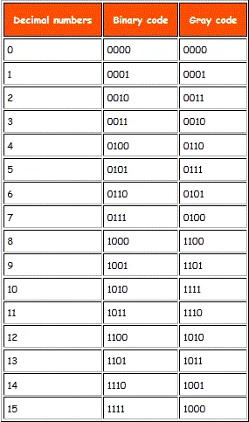

Gray Code
Gray code – also known as Cyclic Code, Reflected Binary Code (RBC), Reflected Binary (RB) or Grey code
Gray code has applications in analog to digital converters, as well as being used for error correction in digital communication

Slide 3
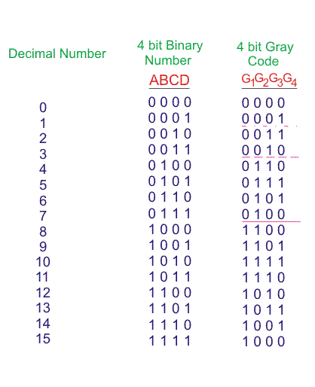

G1 = F1 (A, B, C, D) = ∑m (8,9,10,11,12,13,14,15)
G2= F2 (A, B, C, D) = ∑m (4,5,6,7,8,9,10,11)
G3 = F3 (A, B, C, D) = ∑m (2,3,4,5,10,11,12,13)
G4 = F4 (A, B, C, D) = ∑m (01,2,5,6,9,10,13,14)

Slide 4
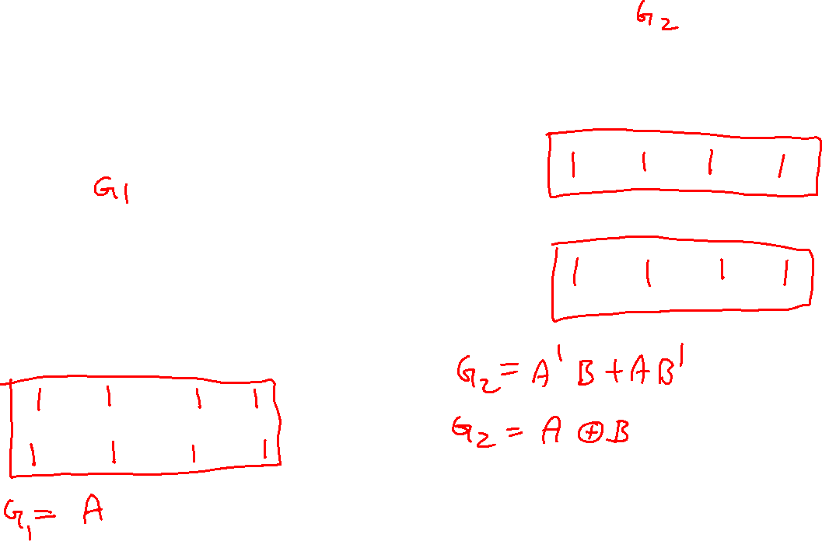
G1 = F1 (A, B, C, D) = ∑m (8,9,10,11,12,13,14,15)
G2= F2 (A, B, C, D) = ∑m (4,5,6,7,8,9,10,11)
G3 = F3 (A, B, C, D) = ∑m (2,3,4,5,10,11,12,13)
G4 = F4 (A, B, C, D) = ∑m (1,2,5,6,9,10,13,14)
 | C’D’ | C’D | CD | CD’
A’B’
A’B
AB
AB’
 | C’D’ | C’D | CD | CD’
A’B’
A’B
AB
AB’

Slide 5
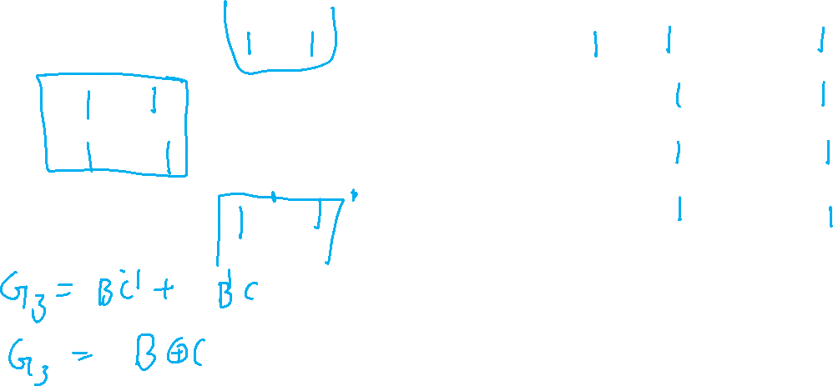

G3 = F3 (A, B, C, D) = ∑m (2,3,4,5,10,11,12,13) G4 = F4 (A, B, C, D) = ∑m (1,2,5,6,9,10,13,14)
 | C’D’ | C’D | CD | CD’
A’B’
A’B
AB
AB’
 | C’D’ | C’D | CD | CD’
A’B’
A’B
AB
AB’

Slide 6
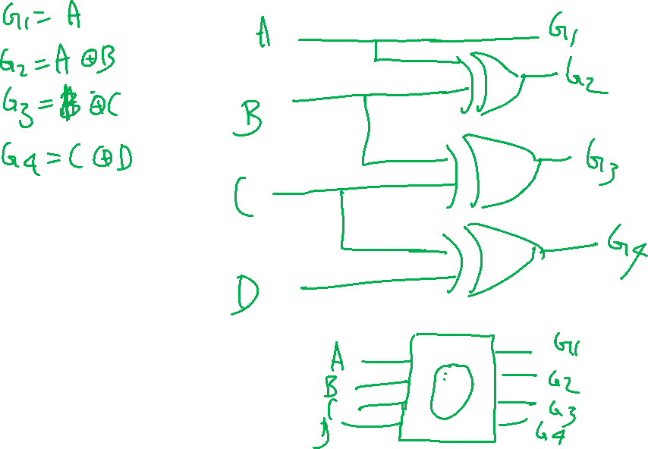

Slide 7
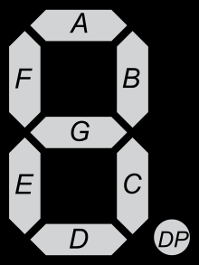
BCD to 7 segment display

Slide 8
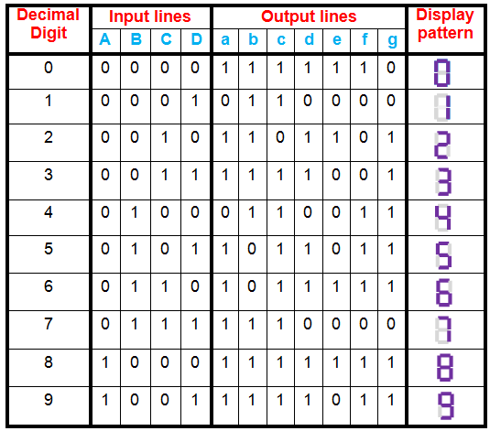
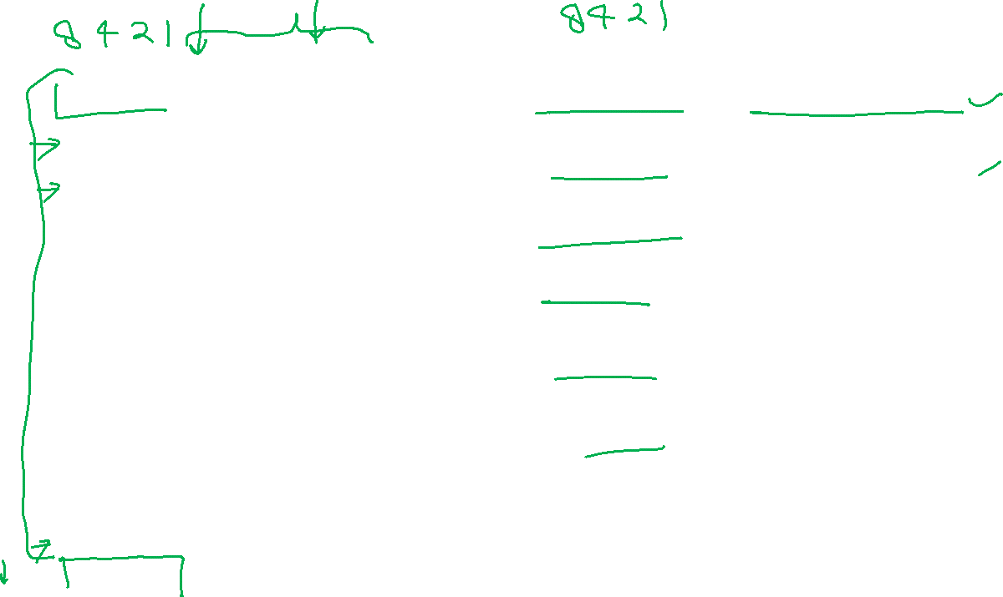
a = F1 (A, B, C, D) = ∑m (0, 2, 3, 5, 6, 7, 8, 9)
b = F2 (A, B, C, D) = ∑m (0, 1, 2, 3, 4, 7, 8, 9)
c = F3 (A, B, C, D) = ∑m (0, 1, 3, 4, 5, 6, 7, 8, 9)
d = F4 (A, B, C, D) = ∑m (0, 2, 3, 5, 6, 8)
e = F5 (A, B, C, D) = ∑m (0, 2, 6, 8)
f = F6 (A, B, C, D) = ∑m (0, 4, 5, 6, 8, 9)
g = F7 (A, B, C, D) = ∑m (2, 3, 4, 5, 6, 8, 9)

Slide 9
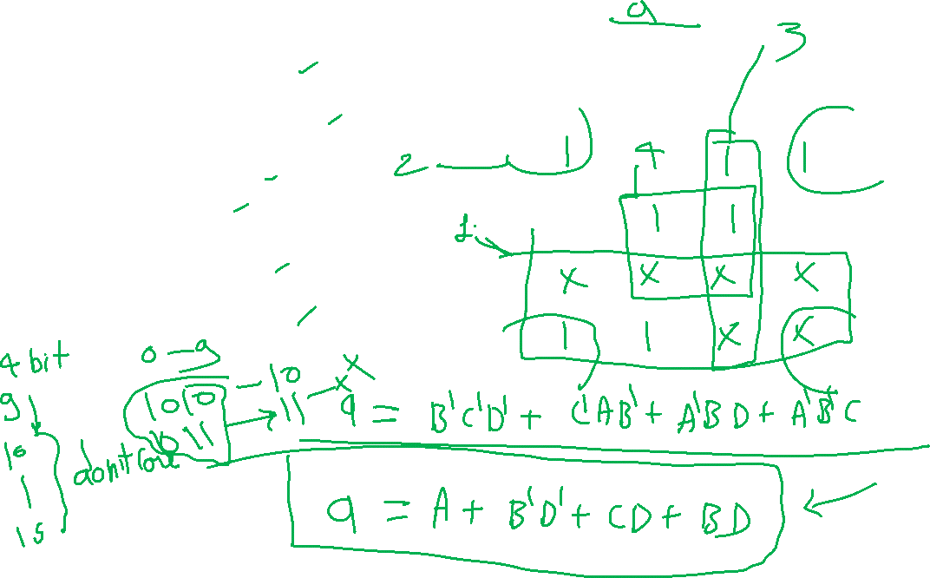
a = F1 (A, B, C, D) = ∑m (0, 2, 3, 5, 7, 8, 9)
b = F2 (A, B, C, D) = ∑m (0, 1, 2, 3, 4, 7, 8, 9)
c = F3 (A, B, C, D) = ∑m (0, 1, 3, 4, 5, 6, 7, 8, 9)
d = F4 (A, B, C, D) = ∑m (0, 2, 3, 5, 6, 8)
e = F5 (A, B, C, D) = ∑m (0, 2, 6, 8)
f = F6 (A, B, C, D) = ∑m (0, 4, 5, 6, 8, 9)
g = F7 (A, B, C, D) = ∑m (2, 3, 4, 5, 6, 8, 9)
 | C’D’ | C’D | CD | CD’
A’B’
A’B
AB
AB’

Slide 10
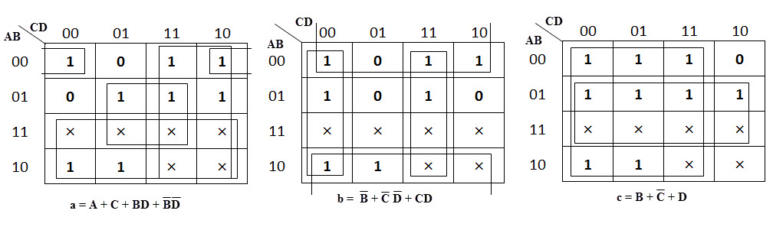
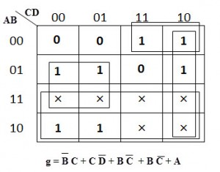
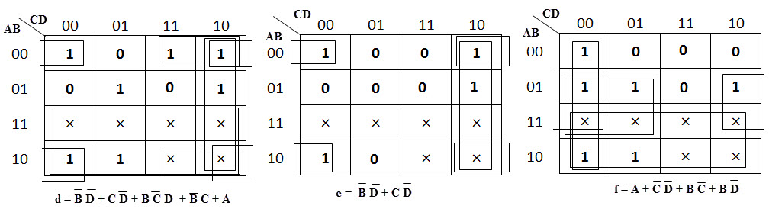
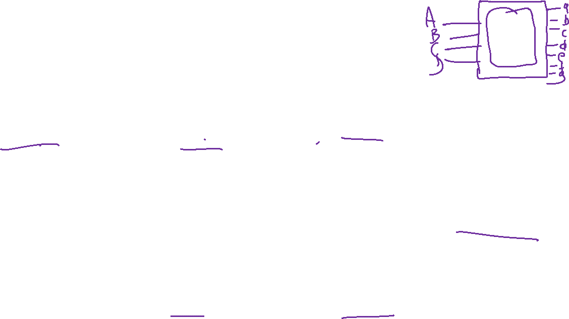

Slide 11
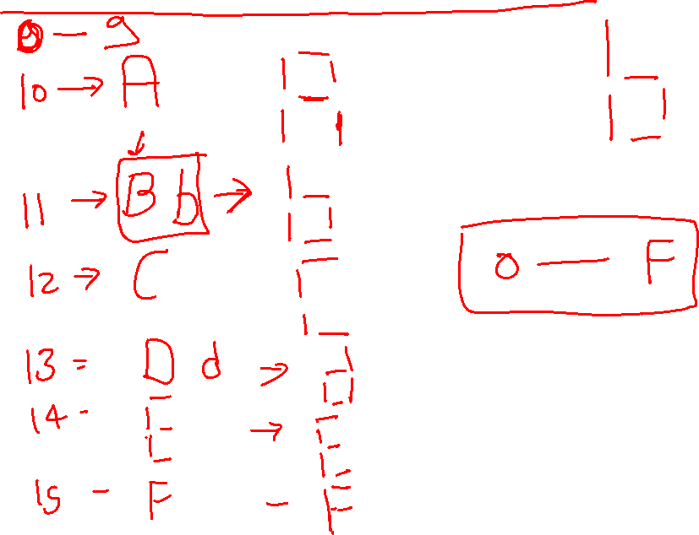
Hexadecimal with 7- segment

